Slide 1
Cloud Computing Project Plan
Kranthi kiran reddy vanga.(16274077)
Bhavaz AKULA.(17282638)

Slide 2
Big-Data Benchmarks

Slide 3
Why big data BENCHMARKS?
Often we are overwhelmed with number of tools available for a purpose.
Particularly, Big data ecosystem is exploding along with the data.
Companies often tend to have most of them if not all and end up using very few.
Big data benchmarks help user to find which tool has to be used for required purpose.
It concentrates on evaluating querying tools hive, impala, sparkSQL, Hbase.

Slide 4
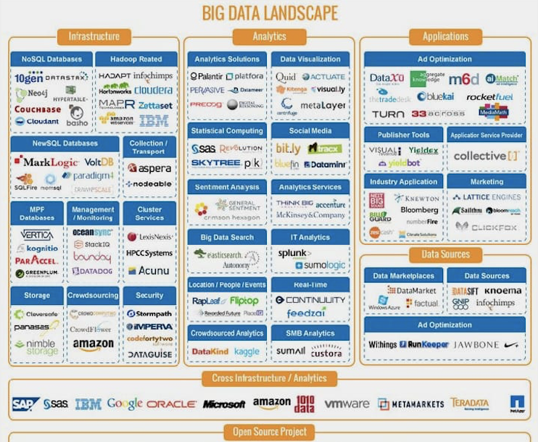

Slide 5
Motivation.
Buried under such a large landscape we want to find ways to breathe easy.
Have handful of tools useful for the purpose.
We want to come up with a solution. ‘Right tool at right time’.
To start with we have chosen querying tools that are popular.

Slide 6
Our PATH Towards our GOAL.
We would use cloud services to set up Hadoop cluster and running environment for all the tools.
Choose three categories of data based on size.
Choose multiple objectives as a user and perform tasks using all the tools we mentioned.
Come up with numbers and factors the helps user to choose tool that suits his purpose.
This saves user’s time of setting up irrelevant tools. Remind you setting up these tools is a lot involved process at scale which firms use.

Slide 7
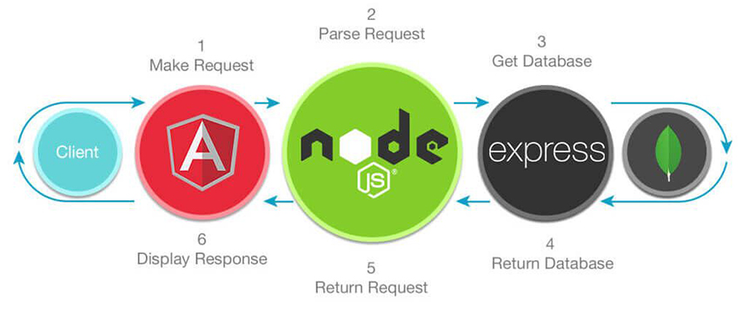
Architecture
Mean Stack
Cloud
PIG
HIVE
IMPALA
SPARK-SQL
HDFS
CLOUD DATABASE

Slide 8
Intended outcome.
No more confusion on picking right tool for the purpose.
Give us the size of data and most frequent operations that would be performed we would find right tool for you.

Slide 9
References.
www.hexanika.com.
www.pintrest.com.

Slide 10
Thank you!

